Slide 1
Analysing the Characteristics of Neural Networks for the Recognition of Sugar Beets
Luca Brodo – Winter Semester 2021

Slide 2
Why are we here?
We want to find correlations between the characteristics of Neural Networks.
In the settings of sugar beet production
Why sugar beets?

Slide 3
How are we going to do that?
Discover the characteristics we are interested in
Develop a toolbox
Analyse the networks

Slide 4
The characteristics:
Training time
Inference time
Accuracy
Loss

Slide 5
Our Tool:
Relevant
Reproducible
Fair
Verifiable

Slide 6
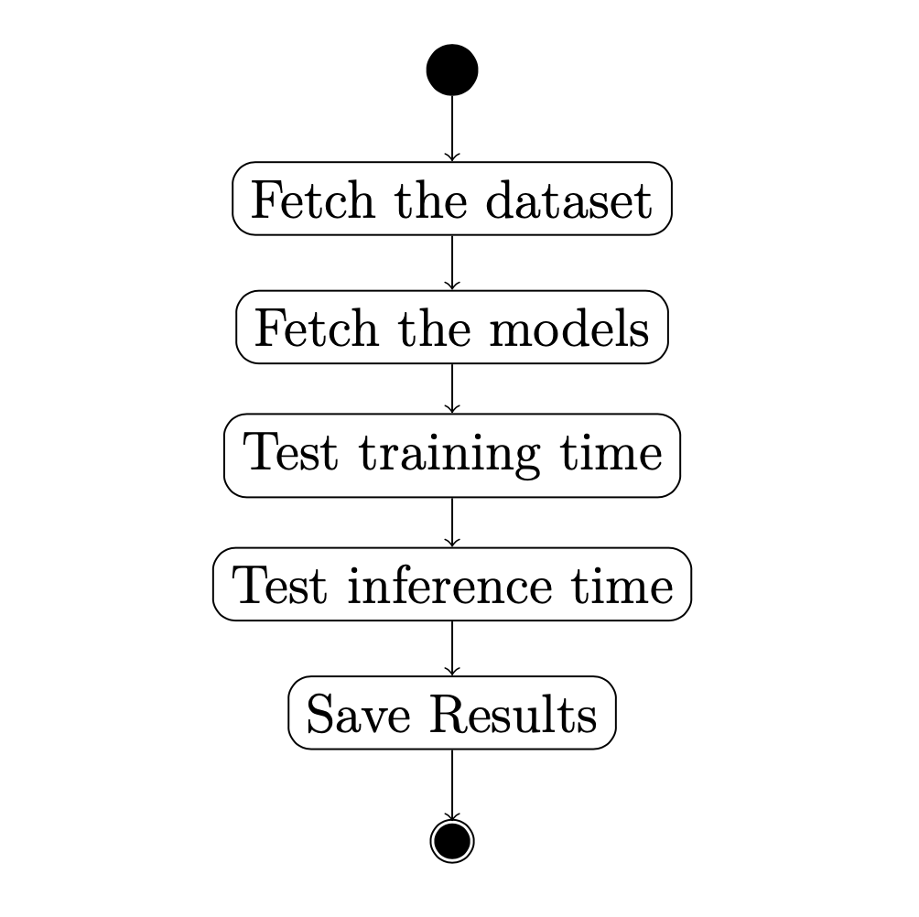
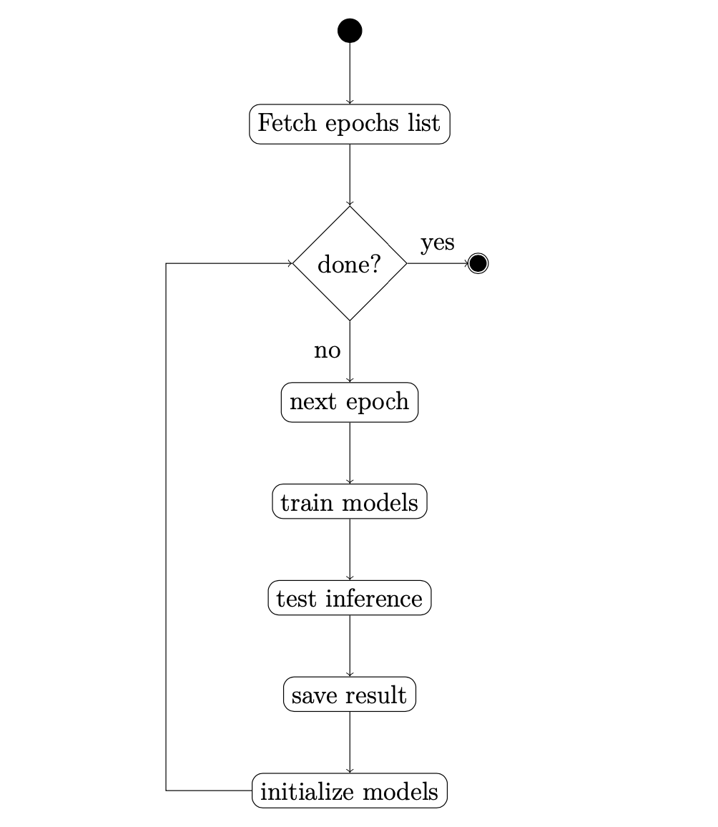

Slide 7
What else can we do?
Analyse both training and inference time with grey-scale version
Further analysis on the slowest images
Analysis of the training and validation loss

Slide 8
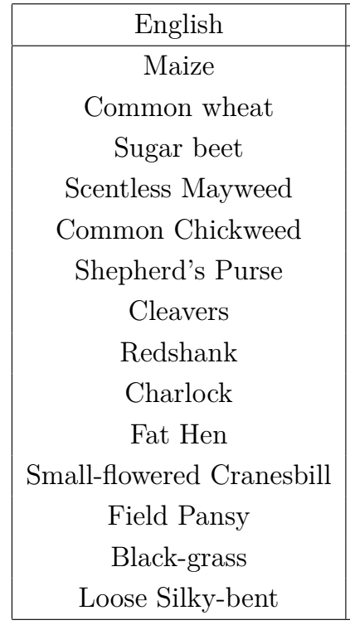
Use case
“Plants_seedlings_v2” dataset
~1000 images of seedlings of 12 species
10 pixels per mm

Slide 9
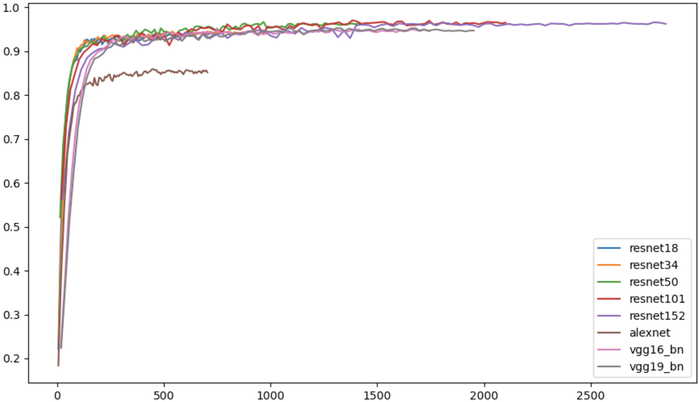
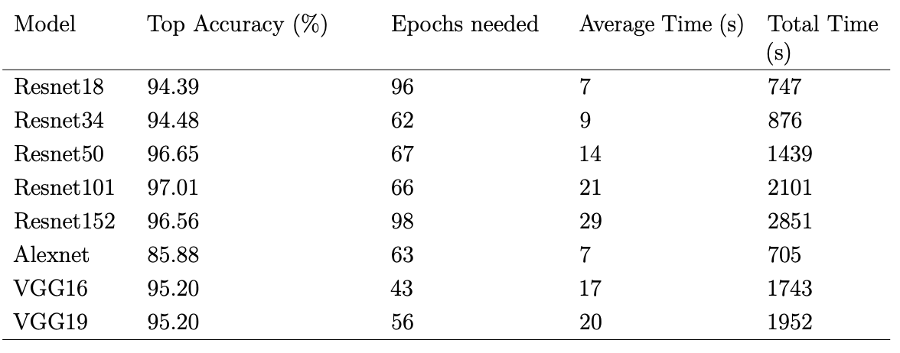
Training time

Slide 10
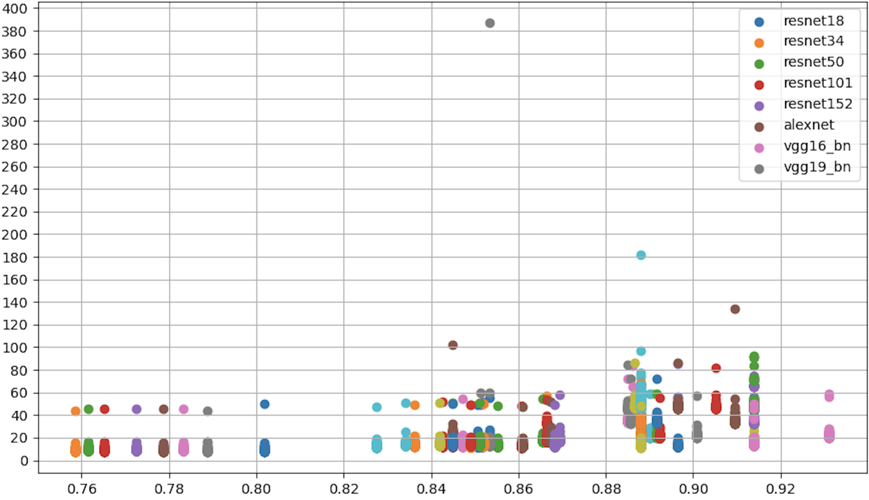
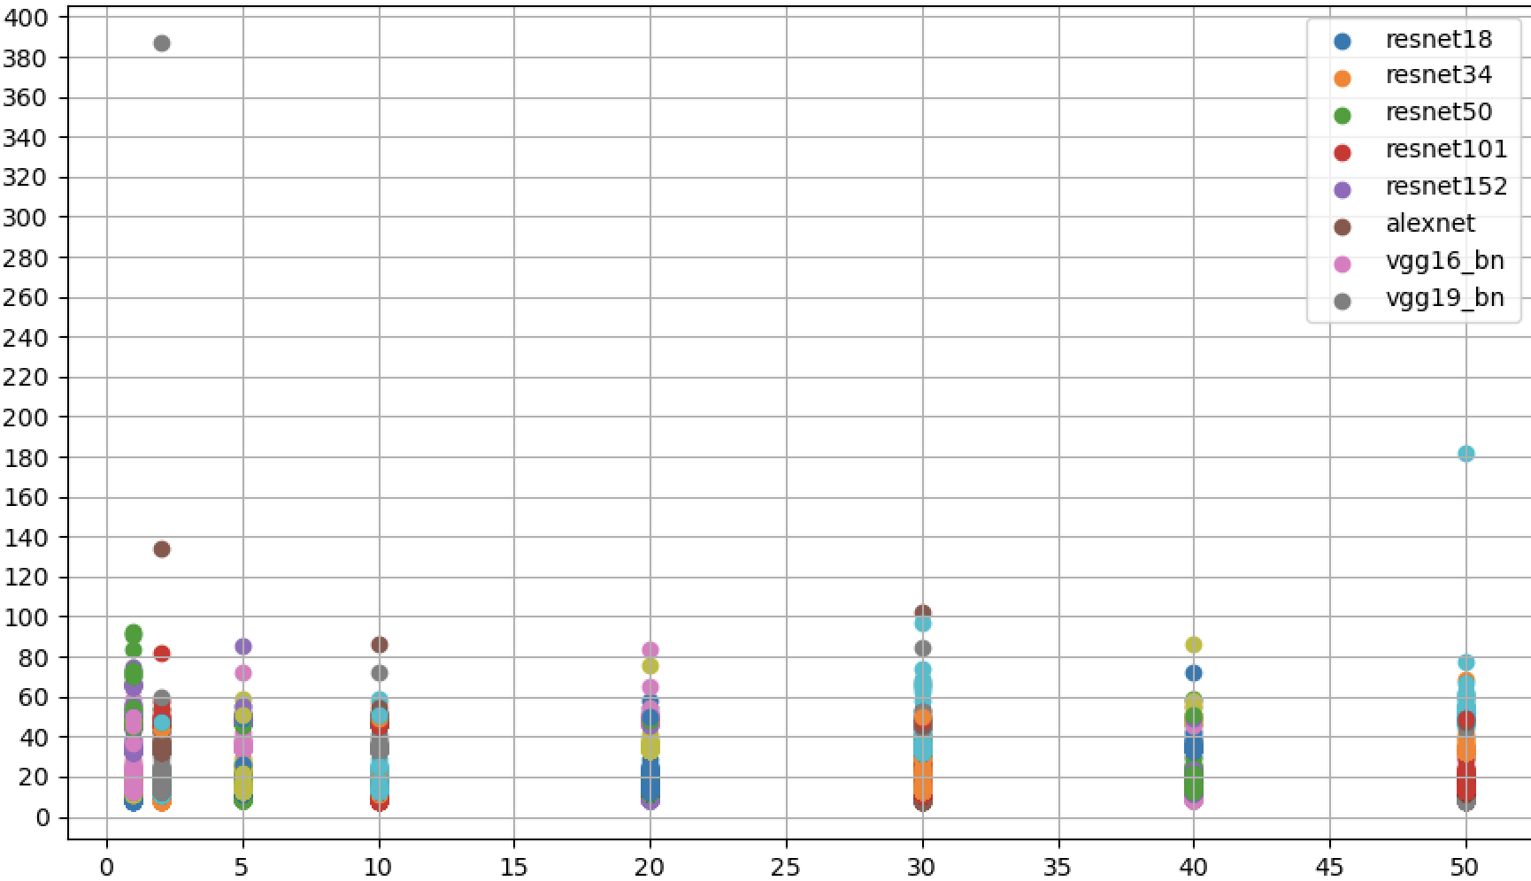
Inference time
Inference time (s)
Accuracy
Epoch

Slide 11
The inference time is related to the amount of the NN layers
Inference time is related to training time
We can relate accuracy to inference time

Slide 12
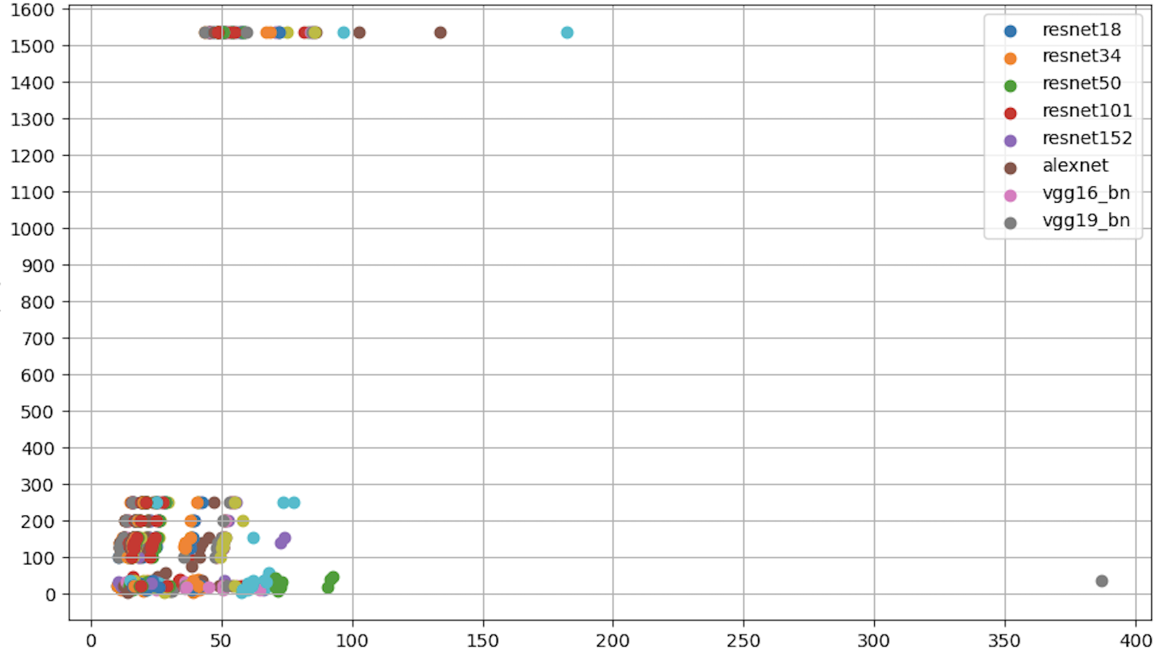
Size (kb)
Inference time

Slide 13
The attributes of the pictures influence inference time
Resolution
Dimensions
If so, we expect bigger pictures to take more time

Slide 14
Conclusion
What else can we do?
Finding more characteristics
Finding more correlations
Study input images
Training images
Finding characteristics of the images to use
Develop a tool to automatically study these characteristics

Slide 15
Conclusion
How can we optimize applications with this method?
Can we create contracts using these correlations?
First milestone to make sugar beet recognition more efficient
Promising research field with a lot of potential

Slide 16
References

